Slide 1
RDBMS and Data Handling using SQL Server
Basic SQL Queries

Slide 2
Objective
What is SQL?
Understanding DQL,DML,DDL rights
Data Integrity and it’s types
Creating, altering and dropping tables
Retrieving data
Summarizing data

Slide 3
What is SQL?
Is the core language used to store, access, and modify data.
Can be categorized as:
Data Definition Language (DDL):
Is used to define the database, data types, structures, and constraints on the data.
Data Manipulation Language (DML):
Is used to manipulate the data in the database objects.
Data Control Language (DCL):
Is used to control the data access in the database.
Data Query Language (DQL):
Is used to query data from the database objects.

Slide 4
What is SQL?
Some of the DDL statements are:
CREATE
ALTER
DROP
Some of the DML statements are:
INSERT
UPDATE
DELETE
Some of the DCL statements are:
GRANT
REVOKE

Slide 5
Creating, altering and dropping tables
The following SQL statement creates a database named Personnel to store the data related to all the employees:
CREATE DATABASE Personnel
The sp_renamedb stored procedure:
Is used to rename a database.
Syntax:
sp_renamedb old_database_name, new_database_name
For example:
sp_renamedb Personnel, Employee
Creates a database named Personnel in the C:\Program Files\Microsoft SQL Server\MSSQL10.MSSQLSERVER\MSSQL\DATA folder.

Slide 6
Creating, altering and dropping tables
The DROP DATABASE statement:
Is used to delete a database.
Syntax:
DROP DATABASE database_name
For example:
DROP DATABASE Employee
Deletes the Employee database.

Slide 7
Creating, altering and dropping tables
The CREATE TABLE statement:
Is used to create a table.
Syntax:
CREATE TABLE
[ database_name . [ schema_name ] .] table_name
( { <column_definition> | <computed_column_definition> }
[IDENTITY (SEED, INCREMENT)]
[ <table_constraint> ] [ ,...n ] )
[ ON { partition_scheme_name ( partition_column_name ) | filegroup
| "default" } ]
[ { TEXTIMAGE_ON { filegroup | "default" } ]
[ ; ]

Slide 8
Creating, altering and dropping tables
You can use the following statement to create the EmployeeLeave table:
CREATE TABLE HumanResources.EmployeeLeave
(
EmployeeID int NOT NULL,
LeaveStartDate datetime NOT NULL,
LeaveEndDate datetime NOT NULL,
LeaveReason varchar(100),
LeaveType char(2)NOT NULL
)
You can use the following statement to view the structure of HumanResources.EmployeeLeave table:
sp_help 'HumanResources.EmployeeLeave'

Slide 9
Creating, altering and dropping tables
You can use the following statement to create an IDENTITY column in a table:
CREATE TABLE Emp(
EmpCode int IDENTITY(100,1),
EmpName char(25) NOT NULL,
DeptNo char(4) NOT NULL)
The EmpCode column of the Emp table is the IDENTITY column with the starting value (SEED) as 100 and the step value (INCREMENT) as 1.

Slide 10
Data Integrity and it’s types

Slide 11
Implementing Data Integrity
Data integrity:
Is enforced to ensure that the data in a database is accurate, consistent, and reliable.
Is broadly classified into the following categories:
Entity integrity
Domain integrity
Referential integrity

Slide 12
Implementing Data Integrity
When creating tables, SQL Server allows you to maintain integrity by:
Applying constraints.
Enabling and disabling constraints.

Slide 13
Implementing Data Integrity
Constraints:
Define rules that must be followed to maintain consistency and correctness of the data.
Can be either created while creating a table or added later.
Check the existing data if added after the creation of the table.
Can be created by using either of the following statements:
CREATE TABLE statement
ALTER TABLE statement

Slide 14
Implementing Data Integrity
Syntax:
CREATE TABLE table_name
(
column_name CONSTRAINT constraint_name constraint_type [,CONSTRAINT constraint_name constraint_type]
)
Constraints can be divided into the following types:
Primary key constraint
Unique constraint
Foreign key constraint
Check constraint
Default constraint

Slide 15
Implementing Data Integrity
Primary key constraint:
Is defined on a column or a set of columns whose values uniquely identify all the rows in a table.
Ensures entity integrity.
Syntax:
CREATE TABLE table_name
(
col_name [CONSTRAINT constraint_name PRIMARY KEY [CLUSTERED|NONCLUSTERED]
col_name [, col_name [, col_name [, …]]]
)
For example:
CREATE TABLE HumanResources.Project (
ProjectCode int CONSTRAINT pkProjectCode PRIMARY KEY,
…
)

Slide 16
Implementing Data Integrity
Unique constraint:
Is used to enforce uniqueness on non-primary key columns.
Is similar to the primary key constraint except that it allows one NULL row.
Syntax:
CREATE TABLE table_name (
col_name [CONSTRAINT constraint_name UNIQUE [CLUSTERED | NONCLUSTERED]
(col_name [, col_name [, col_name [, …]]]))
For example:
CREATE TABLE HumanResources.Project (
ProjectCode int CONSTRAINT pkProjectCode PRIMARY KEY,
Description varchar(50) CONSTRAINT unDesc UNIQUE,
…
)

Slide 17
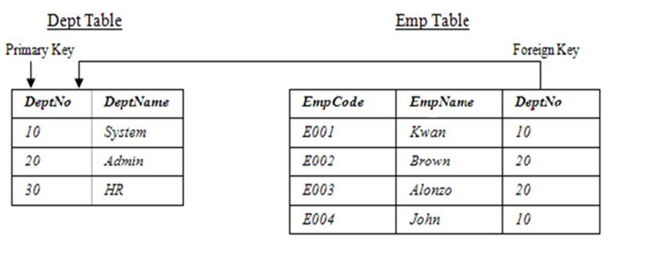
Implementing Data Integrity
Foreign key constraint:
Removes the inconsistency in two tables when the data in one table depends on the data in another table.
Always refers the primary key column of another table, as shown in the following figure.

Slide 18
Implementing Data Integrity
Syntax:
CREATE TABLE table_name (
col_name [CONSTRAINT constraint_name FOREIGN KEY (col_name [, col_name [, …]])
REFERENCES table_name (column_name [, column_name [, …]])]
(col_name [, col_name [, col_name [, …]]])
)
For example:
CREATE TABLE HumanResources.EmployeeLeave (
EmployeeID int CONSTRAINT fkEmployeeID REFERENCES HumanResources.Employee(EmployeeID),
LeaveStartDate datetime CONSTRAINT cpkLeaveStartDate PRIMARY KEY(EmployeeID, LeaveStartDate),
…
)

Slide 19
Implementing Data Integrity
The cascading referential integrity constraint:
Defines the action that SQL Server performs when an attempt is made to update or delete a row in a table with a key referenced by a foreign key in another table.
SQL Server supports the ON DELETE and ON UPDATE clauses to apply the cascading referential integrity constraint.
The ON DELETE and ON UPDATE clauses can be used with the following options:
ON DELETE | ON UPDATE NO ACTION
ON DELETE | ON UPDATE CASCADE
ON DELETE | ON UPDATE SET NULL
ON DELETE | ON UPDATE SET DEFAULT

Slide 20
Implementing Data Integrity
For example:
ALTER TABLE HumanResources.EmployeeLeave
ADD CONSTRAINT rfkcEmployeeID FOREIGN KEY(EmployeeID)
REFERENCES HumanResources.Employee(EmployeeID)
ON DELETE NO ACTION ON UPDATE NO ACTION
Ensures that any attempt to delete or update the EmployeeID in the Employee table will not be successful.

Slide 21
Implementing Data Integrity
Check constraint:
Enforces domain integrity by restricting the values to be inserted in a column.
Syntax:
CREATE TABLE table_name
(
col_name [CONSTRAINT constraint_name] CHECK (expression)
(col_name [, col_name [, …]])
.
)
Can be specified by using the following keywords:
IN
LIKE
BETWEEN

Slide 22
Implementing Data Integrity
IN:
Is used to ensure that the values entered are from a list of constant expressions.
For example:
CREATE TABLE HumanResources.EmployeeLeave
(
EmployeeID int,
LeaveStartDate datetime CONSTRAINT cpkLeaveStartDate PRIMARY KEY(EmployeeID, LeaveStartDate),
LeaveEndDate datetime NOT NULL,
LeaveReason varchar(100),
LeaveType char(2) CONSTRAINT chkLeave CHECK(LeaveType IN('CL','SL','PL'))
)

Slide 23
Implementing Data Integrity
LIKE:
Is used to ensure that the values entered in specific columns are of a certain pattern.
Wild Card characters are used to search a string by using the following wildcard characters:
%
_
[]
[^]
Matches the given character string with the specified pattern.
For example:
CREATE TABLE Emp
(
...
...
DeptCode char(4) CHECK (DeptCode LIKE '[0-9][0-9][0-9][0-9]')
)

Slide 24
Implementing Data Integrity
BETWEEN:
Is used to specify a range of constant expressions by using the BETWEEN keyword.
For example:
CREATE TABLE EmpTable
(
...
...
sal money CHECK (sal BETWEEN 20000 AND 80000)
)

Slide 25
Implementing Data Integrity
Default constraint:
Can be used to assign a constant value to a column, and the user need not insert values for such a column.
Syntax:
CREATE TABLE table_name (
col_name [CONSTRAINT constraint_name] DEFAULT (constant_expression | NULL)
(col_name [, col_name [, …]])
)
For example:
CREATE TABLE HumanResources.EmployeeLeave
(
……
LeaveType char(2) CONSTRAINT chkLeave CHECK(LeaveType IN('CL','SL','PL')) CONSTRAINT chkDefLeave DEFAULT 'PL'
)

Slide 26
Modifying a Table
You need to modify tables when there is a requirement to add or remove columns and constraints.
You can use the ALTER TABLE statement to modify a table.
Syntax:
ALTER TABLE [ database_name . [ schema_name ]
. | schema_name . ]
table_name
{ ALTER COLUMN column_name
{ [ NULL | NOT NULL ]
} | [ WITH { CHECK | NOCHECK } ] ADD COLUMN
<column_definition>
{ ADD CONSTRAINT constraint_name
constraint_type

Slide 27
Modifying a Table
For example:
ALTER TABLE HumanResources.EmployeeLeave
ADD ApprovedBy VARCHAR(30) NOT NULL
You can drop a constraint by using the ALTER TABLE statement.
Syntax:
ALTER TABLE [ database_name . [ schema_name ]|schema_name . ] table_name DROP CONSTRAINT constraint_name
For example:
ALTER TABLE HumanResources.EmployeeLeave DROP CONSTRAINT chkDefLeave

Slide 28
Dropping Table
You can delete a table by using the DROP TABLE statement.
Syntax:
DROP TABLE [ database_name . [ schema_name ] . ] table_name
For example:
DROP TABLE HumanResources.EmployeeVacation

Slide 29
Storing Data in a Table
Data can be stored in a table:
In the form of rows.
By using the INSERT statement.
Syntax:
INSERT [INTO] {table_name} [(column_list)] VALUES {DEFAULT | values_list | select_statement}
The following table describes the structure of the EmpData table.
Column Names | Data Type | Checks
EmpName | varchar(20) | NULL
EmpNo | int | NOT NULL
EmpAddress | varchar(60) | NULL
Salary | int | NULL
EmpName | varchar(20) | NULL

Slide 30
Storing Data in a Table
To insert a row into the EmpData table with all the column values, you can use the following statements:
INSERT EmpData
VALUES ('Yang Kan', 101, '123 Nanjing Lu', 2500)
OR
INSERT EmpData (EmpName, EmpAddress, EmpNo,
Salary) VALUES ('Yang Kan', '123 Nanjing Lu', 101,
2500)
OR
INSERT EmpData (EmpName, EmpAddress,
Salary, EmpNo) VALUES ('Yang Kan', '123 Nanjing
Lu', 2500, 101)

Slide 31
Storing Data in a Table
Copying data from an existing table into a new table:
While inserting data in a table, you can copy rows from an existing table to another table by using the SELECT statement.
The following statement copies the values from the EmployeePayHistory table into the PreferredEmployee table:
SELECT * INTO PreferredEmployee
FROM HumanResources.EmployeePayHistory
WHERE Rate >= 35

Slide 32
Updating Data in a Table
Data in a table can be updated:
When there is a change in the data.
By using the UPDATE statement.
Syntax:
UPDATE table_name
SET column_name = value [, column_name =
value]
[FROM table_name]
[WHERE condition]
You need to consider the following guidelines while updating data:
An update can be done on only one table at a time.
If an update violates integrity constraints, then the entire update is rolled back.

Slide 33
Updating Data in a Table
The following table displays sample data from the EmpData table.
The following statement updates the address of the employee having EmpNo 101:
UPDATE EmpData
SET EmpAddress = '123 Shi Lu'
WHERE EmpNo = 101
EmpName | EmpNo | EmpAddress | Salary
Yang Kan | 101 | 123 Nanjing Lu | 2500
John | 102 | 123 Nanjing Lu | 3500
Michel | 103 | 124 Nanjing Lu | 2200
Shelda | 104 | 693 Park Street | 3500

Slide 34
Deleting Data in a Table
Data in a table can be deleted:
When the data is no longer required.
By using the DELETE statement.
Syntax:
DELETE [FROM] table_name
FROM table(s)]
WHERE condition]

Slide 35
Deleting Data in a Table
Deleting data from related tables:
While deleting data from related tables, you first need to delete the records from the table that contains the foreign key.
After that, you can delete the record from the table that contains the primary key.
For example:
DELETE FROM HumanResources.Employee
WHERE BirthDate < dateadd(yy, -60, getdate())
Deleting all the records from a table:
By using the DELETE statement.
By using the TRUNCATE DML statement.
For example:
TRUNCATE TABLE EmpData
Deletes all the records from the EmpData table.

Slide 36
Retrieve Data

Slide 37
Retrieving Specific attributes
The SELECT statement is used for accessing and retrieving data from a database.
Syntax:
SELECT [ALL | DISTINCT] select_column_list [INTO [new_table_name]] [FROM {table_name | view_name} [WHERE search_condition]

Slide 38
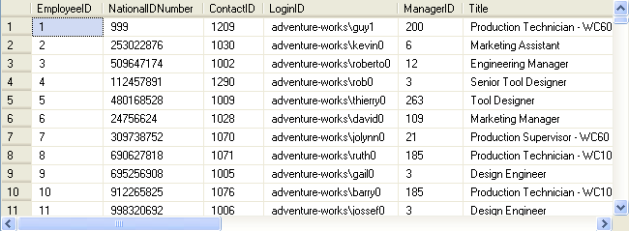
Retrieving Specific attributes
To display all the details of employees, you can use the following query:
SELECT * FROM HumanResources.Employee

Slide 39
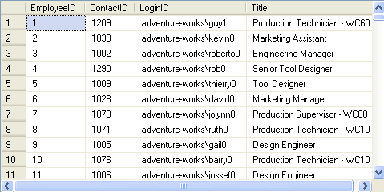
Retrieving Specific attributes
To view specific details, you can specify the column names in the SELECT statement, as shown in the following query:
SELECT EmployeeID, ContactID, LoginID, Title
FROM HumanResources.Employee

Slide 40
Retrieving Specific attributes
You can write the query in the following ways:
SELECT 'Department Number'= DepartmentID,'Department Name'= Name FROM HumanResources.Department
SELECT DepartmentID 'Department Number', Name 'Department Name' FROM HumanResources.Department
SELECT DepartmentID AS 'Department Number', Name AS 'Department Name'FROM HumanResources.Department

Slide 41
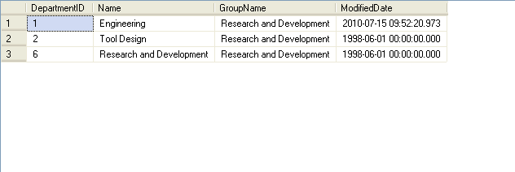
Retrieving Specific rows
Selected rows can be retrieved using the WHERE clause in the SELECT statement.
The following SQL query retrieves the department details from the Department table, where the group name is Research and Development:
SELECT * FROM HumanResources.Department
WHERE GroupName = 'Research and Development'

Slide 42
Retrieving Specific rows
NULL values:
Can be retrieved by using the IS NULL keyword with the SELECT statement.
Syntax:
SELECT column_list FROM table_name WHERE column_name unknown_value_operator
For example:
SELECT EmployeeID, EndDate FROM HumanResources.EmployeeDepartmentHistory WHERE EndDate IS NULL
Retrieves only those rows from the EmployeeDepartmentHistory table for which value in the EndDate column is NULL.

Slide 43
Retrieving Specific rows
ORDER BY clause:
Can be used with the SELECT statement to display records in a specific order.
Displays record in ascending or descending order.
Syntax:
SELECT select_list
FROM table_name
[ORDER BY order_by_expression [ASC|DESC]
[, order_by_expression [ASC|DESC]…]

Slide 44
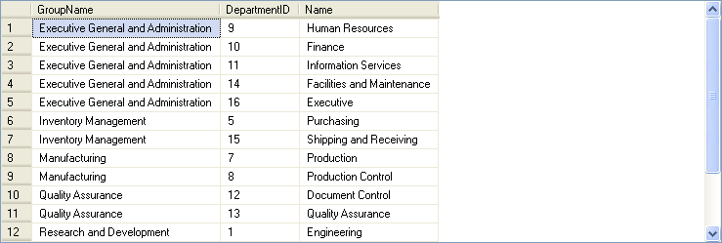
Retrieving Specific rows
For example:
SELECT GroupName, DepartmentID, Name FROM HumanResources.Department ORDER BY GroupName, DepartmentID

Slide 45
Retrieving Specific rows
TOP keyword:
Can be used with the SELECT statement to retrieve only the first set of rows from the top of a table.
Syntax:
SELECT [TOP n [PERCENT]] column_name
[,column_name…]
FROM table_name
WHERE search_conditions
[ORDER BY [column_name[,column_name…]
For example:
SELECT TOP 10 * FROM HumanResources.Employee
Retrieves the top 10 rows of the Employee table.

Slide 46
Retrieving Specific rows
DISTINCT keyword:
Eliminates the duplicate rows from the result set.
Syntax:
SELECT [ALL|DISTINCT] column_names
FROM table_name
WHERE search_condition
For example:
SELECT DISTINCT Title FROM
HumanResources.Employee
WHERE Title LIKE 'PR%'
Retrieves all the titles beginning with PR from the Employee table.

Slide 47
Summarizing Records

Slide 48
Summarizing Records
Aggregate functions:
Summarize the values for a column or a group of columns, and produce a single value.
Syntax:
SELECT aggregate_function([ALL|DISTINCT] expression) FROM table_name
You can calculate summary values by using the following aggregate functions:
Avg()
Count()
Min()
Max()
Sum()

Slide 49
Summarizing Records
The GROUP BY clause:
Summarizes the result set into groups as defined in the SELECT statement by using aggregate functions.
Uses the HAVING clause to further restrict the result set to produce the data based on a condition.
Syntax:
SELECT column_list
FROM table_name
WHERE condition
[GROUP BY [ALL] expression [, expression]
[HAVING search_condition]

Slide 50
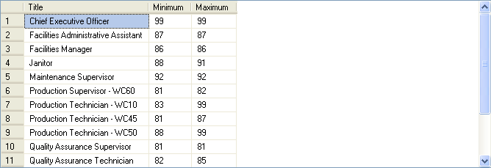
Summarizing Records
For example:
SELECT Title, Minimum = min(VacationHours), Maximum = max(VacationHours) FROM HumanResources.Employee WHERE VacationHours > 80 GROUP BY Title
Displays the minimum and maximum values of vacation hours for the different types of titles.

Slide 51
Summarizing Records
is used to filter data based on the group functions.
Group functions cannot be used in WHERE Clause but can be used in HAVING clause
Example : Display all department number having more than 3 employees
SELECT deptno ,COUNT(*) FROM HumanResources.Employee
GROUP BY deptno HAVING COUNT(*) >3;
DEPTNO COUNT(*)
20 5
30 6

Slide 52
Summary
Types of SQL Commands
The CREATE DATABASE statement is used to create a database, which also includes determining the name of the database, the size of the database, and the files used to store data in the database.
The DROP DATABASE statement is used to delete a database.
Tables are used to store data.
The CREATE TABLE statement is used to create a table.
Data Integrity and it’s types
DML Stataments
Data can be retrieved from a database by using the SELECT statement.
Data of all the columns of a table can be retrieved by specifying * in the SELECT statement.
Data that has to be retrieved based on a condition is specified by adding the WHERE clause.
Literals and user-defined headings are added to change the display.
The concatenation operator is used to concatenate a string expression.
Arithmetic operators are used to perform mathematical operations.
Comparison operators test the similarity between two expressions.

Slide 53
Summary(Contd..)
Logical operators are used in the SELECT statement to retrieve records based on one or matching conditions. The logical operators are AND, OR, and NOT.
Range operators retrieve data based on the range. There are of two types of range operators, BETWEEN and NOT BETWEEN.
The IN keyword allows the selection of values that match any one of the values in a list.
The NOT IN keyword restricts the selection of values that match any one of the values in a list.
The LIKE keyword is used to specify the pattern search.
The IS NULL keyword is used to retrieve missing values.
The ORDER BY clause is used to retrieve data in a specific order.
The TOP keyword retrieves only the first set of rows, which can either be a number or a percent of rows that will be returned from a query result.
The DISTINCT keyword eliminates duplicate rows.

